Slide 1


Introduction to Information Systems
CHAPTER 1 · LECTURE 1
Data, information and the systems that turn one into the other
Data
Processing
Information
Notes:
Welcome to the first lecture of the course. Today is the big-picture introduction: why information systems matter, the difference between data, information and knowledge, how an information system works through input, processing, output and feedback, and the components of a computer-based information system. Then we tour the main types of business information systems, from e-commerce and transaction processing up to management information systems, decision support, and specialized systems like artificial intelligence and virtual reality. We finish with how systems are developed, step by step. The strip at the bottom is the core idea of the whole course: data goes in, it is processed, and useful information comes out.

Slide 2
16 weeks, 4 quizzes, 3 exams
COURSE OUTLINE
01
Introduction
Today
02
Foundations of IS in business
03
Strategy, competitive advantage & IS · Quiz 1
04
Ethics and privacy
05
Information security · Quiz 2
06
Multimedia IS, part 1
07
Midterm exam
08
Multimedia IS, part 2
09
Data and knowledge management
10
E-business and e-commerce · Quiz 3
11
Systems analysis and design
12
Business analytics, part 1 · Exam
13
Business analytics, part 2
14
IS within the organization · Quiz 4
15
Social computing
16
Final exam
Introduction to Information Systems
2
Notes:
Here is the plan for the course. We start today with the introduction, then the foundations of information systems in business in week 2, and organizational strategy, competitive advantage and IS in week 3, followed by Quiz 1. Week 4 is ethics and privacy, and week 5 information security, with Quiz 2. Week 6 is the first part of multimedia information systems, week 7 is the midterm exam, and week 8 is multimedia part 2. Week 9 covers data and knowledge management, and week 10 e-business and e-commerce, with Quiz 3. Week 11 is systems analysis and design, week 12 business analytics part 1 together with the week-12 exam, and week 13 business analytics part 2. Week 14 covers information systems within the organization, with Quiz 4, week 15 social computing, and week 16 is the final exam. The exam weeks are tinted coral so they stand out.

Slide 3


IS can cut costs and increase profits
WHY LEARN ABOUT INFORMATION SYSTEMS?
And students in most fields need to know them. Two examples:
Management major
Biochemistry major
Hired to design a system that improves productivity
Hired to conduct drug research using computer techniques
Introduction to Information Systems
3
Notes:
Why should you learn about information systems? First, because they matter to the bottom line: information systems can cut costs and increase profits. Second, because whatever your major, you will meet them. The lecture gives two examples. A management major might be hired to design a system that improves productivity. A biochemistry major might be hired to conduct drug research using computer techniques. So this is not just a course for computing students: IS knowledge is part of almost every profession. You could ask the class for examples from their own planned careers.

Slide 4





What is an information system?
INTRODUCTION
A set of interrelated components that work on data and information, and provide feedback to meet an objective.
Collect
Manipulate
Store
Distribute
Feedback
EXAMPLES
ATMs
Airline reservation systems
Course reservation systems
Introduction to Information Systems
4
Notes:
An information system, IS, is a set of interrelated components that collect, manipulate, store and distribute data and information, and that provide feedback to meet an objective. Read the definition through the five tiles: it collects data, manipulates or processes it, stores it, distributes the results, and uses feedback to keep improving toward its objective. The lecture’s examples are things you use all the time: ATMs, airline reservation systems, and course reservation systems like the one you used to register for this course. Ask the class to name the inputs and outputs of an ATM, for instance a card and PIN in, cash and a receipt out; that example is ours.

Slide 5



Data are raw facts
INFORMATION CONCEPTS · DATA
Facts on their own, not yet organized. They come in four types (Table 1.1):
A1#
Alphanumeric
Image
Audio
Video
Numbers, letters and other characters
Graphic images and pictures
Sound, noise or tones
Moving images or pictures
Introduction to Information Systems
5
Notes:
Let’s start with the most basic concept. Data are raw facts: things like an employee’s number, the hours worked in a week, or a product code, before anyone has organized them. Table 1.1 in the lecture lists four types of data. Alphanumeric data are represented by numbers, letters and other characters. Image data are graphic images and pictures. Audio data are sound, noise or tones. Video data are moving images or pictures. On their own, raw facts have limited value; the next slide shows what happens when we organize them.

Slide 6
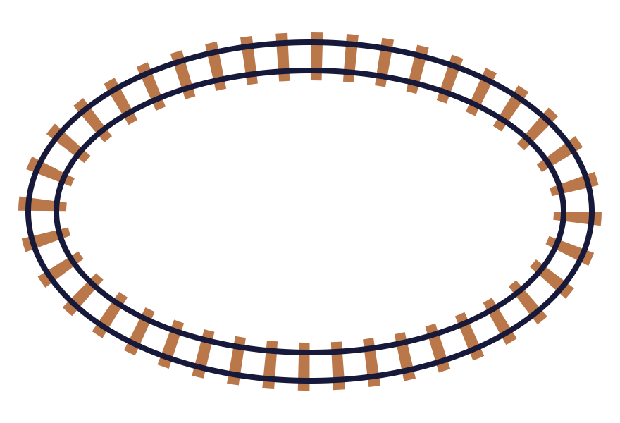
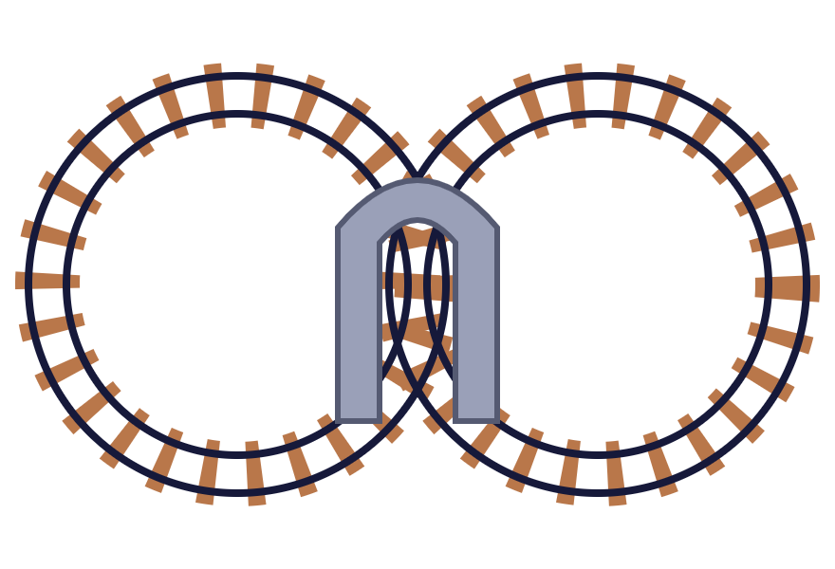
Same pieces, more value
INFORMATION CONCEPTS · INFORMATION
Information: a collection of facts organized so that they have additional value beyond the facts themselves.
(a) A SIMPLE OVAL
(b) A FIGURE EIGHT
Figure 1.1: the same track pieces, arranged differently, give a more interesting layout. Defining relationships among data creates information.
Introduction to Information Systems
6
Notes:
Information is a collection of facts organized in such a way that they have additional value beyond the value of the facts themselves. The lecture’s Figure 1.1 uses toy train track to make the point, and these drawings redraw it simply. In (a), the track pieces form a plain oval. In (b), exactly the same kinds of pieces, plus a tunnel, form a figure eight. Nothing new was added in terms of raw material; what changed is how the pieces relate to one another, and the result is a more interesting and more valuable layout. Data work the same way: defining and organizing relationships among data creates information. For example, a list of sales figures becomes far more useful when it is organized by month and region; that example is ours.

Slide 7




Knowledge turns data into information
INFORMATION CONCEPTS · KNOWLEDGE
THE TRANSFORMATION PROCESS
Applying knowledge by selecting, organizing and manipulating data
Data
Information
SELECT
ORGANIZE
MANIPULATE
Pick only the facts that matter
Arrange them and define relationships
Calculate, sort and summarize
Introduction to Information Systems
7
Notes:
Figure 1.2 shows the process of transforming data into information. Data enter a transformation process, which means applying knowledge by selecting, organizing and manipulating data, and information comes out. This is where the third concept in the title fits: knowledge is what lets us know which data to select, how to organize them, and how to manipulate them so the result is useful. The textbook defines knowledge as the awareness and understanding of a set of information and the ways it can be made useful to support a specific task or reach a decision; the lecture slides don’t print that definition, so treat it as background. A simple classroom example of ours: a teacher has everyone’s raw exam marks; selecting this class, organizing by student and calculating the average turns them into a class report.

Slide 8


Information is worth what it helps you achieve
THE VALUE OF INFORMATION
Its value is directly linked to how it helps decision makers achieve their organization’s goals. It might be measured in:
Time
Profit
required to make a decision
increased profits to the company
Introduction to Information Systems
8
Notes:
How do we know whether information is valuable? The value of information is directly linked to how it helps decision makers achieve their organization’s goals. Information that nobody uses to make a better decision has little value, however accurate it is. The lecture gives two ways to measure it. First, the time required to make a decision: good information can cut a decision from days to minutes. Second, increased profits to the company: for example, information that helps a manager stock the right products can raise sales. Both of those illustrations are ours; the two measures are the lecture’s.

Slide 9




Input, processing, output, feedback
FIGURE 1.3 · THE COMPONENTS OF AN IS
FEEDBACK
Input
Processing
Output
Gathering and capturing raw data
Converting or transforming data into useful outputs
Useful information, usually documents and reports
Feedback: output used to make changes to input or processing activities
Introduction to Information Systems
9
Notes:
Figure 1.3 shows the components of an information system: input, processing, output and feedback. Input is the activity of gathering and capturing raw data, for example recording the hours each employee worked. Processing means converting or transforming data into useful outputs, such as calculating pay. Output is the production of useful information, usually in the form of documents and reports, like a payslip or a payroll report. Feedback is output that is used to make changes to input or processing activities. Notice in the diagram that the feedback line returns from the output to both the input and the processing steps. If a report shows that an employee’s hours were entered wrongly, that feedback leads us to correct the input and run the processing again. The payroll illustration is ours, but it previews the payroll system we will see later in the lecture.

Slide 10




Pencil or program: both are information systems
MANUAL AND COMPUTERIZED SYSTEMS
Manual
Computerized
Developing patterns and trends on graph paper for stock analysis
Program trading tracks the market and trades large blocks of stocks when conflicts occur
Introduction to Information Systems
10
Notes:
An information system does not have to involve a computer. It can be manual or computerized. The lecture’s manual example is an investor developing patterns and trends on graph paper for stock analysis: data in, a human doing the processing with a pencil, a chart out. The computerized example is program trading, where software tracks the market and automatically trades large blocks of stocks when conflicts occur. Both fit the input, processing, output and feedback model; the difference is who, or what, does the processing, and how fast. The rest of this course focuses mainly on computer-based information systems, which come next. The two small charts are only illustrations.

Slide 11






A CBIS is a puzzle of six pieces
COMPUTER-BASED INFORMATION SYSTEMS
A single set of hardware, software, databases, telecommunications, people and procedures,
Hardware
Software
People
configured to collect, manipulate, store and process data into information.
Databases
Telecommunications
Procedures
Introduction to Information Systems
11
Notes:
A computer-based information system, or CBIS, is a single set of hardware, software, databases, telecommunications, people and procedures that are configured to collect, manipulate, store and process data into information. The lecture’s Figure 1.4 draws these as interlocking jigsaw pieces, and that image is the key message: a CBIS only works when all the pieces fit together. Powerful hardware is useless without software, software is useless without data, and none of it works without trained people following good procedures. On the next slide we look at each component in a little more detail, including networks and the Internet, which the lecture lists alongside telecommunications.

Slide 12








What each piece does
CBIS COMPONENTS
Hardware
Software
Database
Telecoms
Equipment for input, processing and output
Programs that govern how the computer operates
Organized collection of facts and information
Electronic transmission of signals for communication
Networks
Internet
People
Procedures
Connect computers in a building, a country or the world
The world’s largest computer network
Manage, run, program and maintain the system
Strategies, policies, methods and rules for using a CBIS
Introduction to Information Systems
12
Notes:
Here are the CBIS components as the lecture defines them. Hardware is the computer equipment used to perform input, processing and output activities. Software is the computer programs that govern the operation of the computer. A database is an organized collection of facts and information. Telecommunications is the electronic transmission of signals for communications. Networks connect computers and equipment in a building, around the country and around the world. The Internet is the world’s largest computer network. People manage, run, program and maintain the system; many experts consider them the most important element. Procedures are the strategies, policies, methods and rules for using a CBIS, for example rules on backups or who may access which data. The people and procedures cards are dark to stress that a CBIS is not just technology.

Slide 13

The business IS pyramid
FIGURE 1.5 · BUSINESS INFORMATION SYSTEMS
The most common types in business:
KM & special-purpose
Electronic & mobile commerce
Transaction processing
MIS & DSS
Management information
Decision support
Specialized business IS
Enterprise systems · E- & M-commerce
Introduction to Information Systems
13
Notes:
Now we move from what an IS is to the kinds of IS businesses actually use. The most common types are electronic and mobile commerce systems, transaction processing systems, management information systems, decision support systems, and specialized business information systems. Figure 1.5 arranges them as a pyramid. At the base are enterprise systems, such as transaction processing and enterprise resource planning, together with e-commerce and m-commerce: the systems that run day-to-day business and handle the most transactions. In the middle are management information systems and decision support systems, which use that data to help managers. At the top are knowledge management and other special-purpose business information systems. The colour key on the right matches each type to its layer. The next slides walk up the pyramid from the base.

Slide 14


Who trades with whom, electronically
ELECTRONIC AND MOBILE COMMERCE
E-commerce: any business transaction executed electronically between parties such as:
B2B
B2C
C2C
Company
↔ company
Company
↔ consumer
Consumer
↔ consumer
Company
↔ public sector
Consumer
↔ public sector
M-commerce is the same idea carried out on mobile, wireless devices
Introduction to Information Systems
14
Notes:
At the base of the pyramid are e-commerce and m-commerce systems. E-commerce is any business transaction executed electronically between parties. The lecture lists five combinations. Business-to-business, B2B: companies trading with each other, such as a car maker ordering parts from a supplier online. Business-to-consumer, B2C: companies selling to consumers, like an online shop. Consumer-to-consumer, C2C: consumers selling to each other, as on an auction or second-hand marketplace site. Companies and the public sector, for example a firm filing taxes online. And consumers and the public sector, for example a citizen renewing a licence online. The examples are ours. Mobile commerce, m-commerce, is the slide title’s other half: the same transactions done through mobile, wireless devices such as smartphones; the lecture names it without defining it, so that line is background from the textbook.

Slide 15




E-business links the whole chain
FIGURE 1.8 · ELECTRONIC BUSINESS
Management
Organization and its partners
Suppliers
Customers
E-PROCUREMENT
E-COMMERCE
Buying from suppliers is e-procurement; selling to customers is e-commerce; management oversees it all.
Introduction to Information Systems
15
Notes:
Figure 1.8 widens the view from e-commerce to electronic business. Goods and information flow from suppliers, through the organization and its partners, to customers. The supplier side is e-procurement, buying electronically; the customer side is e-commerce, selling electronically. Management sits above and directs all three. In the textbook, e-business means using information systems and the Internet to perform all business-related tasks and functions, not just buying and selling; the lecture shows the figure without that definition, so treat it as background. A simple example of ours: a supermarket orders stock from suppliers online, shares sales data with its delivery partners, and sells to customers through its app.

Slide 16



Recording every business exchange
ENTERPRISE SYSTEMS · TPS
TRANSACTION
TRANSACTION PROCESSING SYSTEM
A business-related exchange
TPS
Payments to employees
An organized collection of people, procedures, software, databases and devices used to record completed business transactions.
Sales to customers
Payments to suppliers
Introduction to Information Systems
16
Notes:
Enterprise systems include transaction processing systems and enterprise resource planning. Start with the transaction: a business-related exchange, such as payments to employees, sales to customers, or payments to suppliers. Every organization does thousands of these. A transaction processing system, TPS, is an organized collection of people, procedures, software, databases and devices used to record completed business transactions. Notice the familiar list of components from the CBIS definition: people, procedures, software, databases and devices. The TPS sits at the very base of the pyramid because almost every other system depends on the data it records. Next, a concrete example: payroll.

Slide 17






Payroll: a TPS in action
FIGURE 1.9 · A PAYROLL TPS
Hours worked
Payroll transaction processing
INPUTS
Payroll checks
OUTPUT
Pay rate
ILLUSTRATION
40 hours × $15 per hour = $600 gross pay on the check
Introduction to Information Systems
17
Notes:
Figure 1.9 shows a payroll transaction processing system, the classic example. Two inputs come in: the hours each employee worked and each employee’s pay rate. The payroll transaction processing step combines them, and the output is the payroll checks. This is the input, processing, output model from earlier, applied to a real business transaction. The number at the bottom is our own simple illustration, not from the lecture: 40 hours at 15 dollars an hour gives 600 dollars of gross pay. A real payroll system would also handle deductions such as tax and insurance, and would keep records of every payment for the company’s accounts.

Slide 18




One integrated system for every site
ENTERPRISE RESOURCE PLANNING
ERP: integrated programs that manage a company’s vital business operations for an entire multisite organization. It coordinates:
Planning
Inventory
Production
Ordering
WHY AN EFFECTIVE TPS PAYS OFF
Speeds up business activities
Reduces clerical costs
Its stored data helps managers make better decisions
Introduction to Information Systems
18
Notes:
Enterprise resource planning, ERP, is the other kind of enterprise system. An ERP system is a set of integrated programs capable of managing a company’s vital business operations for an entire multisite organization. Instead of separate systems in each branch or department, one integrated system coordinates planning, inventory control, production and ordering across all sites. The bottom panel comes from the lecture’s bridge slide, “Information and Decision Support Systems”. An effective TPS provides a number of benefits: it can speed business activities and reduce clerical costs, and the data stored in the TPS is used to help managers make better decisions. That last point is the link to the next level of the pyramid: management information and decision support systems build on TPS data.

Slide 19




Routine information for managers
MANAGEMENT INFORMATION SYSTEMS
Marketing MIS
Manufacturing MIS
An organized collection of people, procedures, software, databases and devices that provides routine information to managers and decision makers.
Common
database
PRIMARY FOCUS
Operational efficiency
Financial MIS
Other MIS
TPS
Introduction to Information Systems
19
Notes:
Moving up the pyramid. A management information system, MIS, is an organized collection of people, procedures, software, databases and devices that provides routine information to managers and decision makers. Its primary focus is operational efficiency: helping the organization run its regular operations well. Figure 1.10, redrawn on the right, shows the typical structure. At the centre is a common database, fed by the transaction processing system from below. Around it, functional management information systems for marketing, manufacturing, finance and other areas both draw information from and contribute to the shared database. Routine information here means scheduled reports, such as a weekly sales summary or a monthly inventory report; those examples are ours.

Slide 20





Help with a specific decision
DECISION SUPPORT SYSTEMS
People, procedures, software, databases and devices that support problem-specific decision making.
Database
Model base
FOCUS
Decision-making effectiveness
DBMS
MMS
MIS: routine information → efficiency
DSS: problem-specific support → effectiveness
Internet, intranets, extranets, networks
External database access
Dialogue manager
User interface
Introduction to Information Systems
20
Notes:
A decision support system, DSS, is an organized collection of people, procedures, software, databases and devices that supports problem-specific decision making. Its focus is decision-making effectiveness, making the right decision, whereas the MIS focuses on operational efficiency, doing routine things well. Figure 1.11 shows the essential DSS elements, redrawn on the right. A database, managed by a database management system, DBMS, holds the data. A model base, managed by a model management system, MMS, holds the models used for analysis, such as forecasting or what-if models. The DSS can also reach the Internet, corporate intranets, extranets, networks and other computer systems, and it can access external databases. The decision maker works with it all through the dialogue manager, the user interface. An example of ours: a manager deciding where to open a new branch could run location models against sales data and external population data.

Slide 21


The top of the pyramid
SPECIALIZED BUSINESS INFORMATION SYSTEMS
Knowledge management
Artificial intelligence
Expert systems
Virtual reality
KMS
AI
People, procedures, software, databases and devices to create, store, share and use the organization’s knowledge and experience.
A field in which the computer system takes on the characteristics of human intelligence.
Introduction to Information Systems
21
Notes:
At the top of the pyramid are the specialized business information systems. The lecture names four: knowledge management, artificial intelligence, expert systems and virtual reality. A knowledge management system, KMS, is an organized collection of people, procedures, software, databases and devices to create, store, share and use the organization’s knowledge and experience. Think of a consulting firm keeping a searchable library of past projects and lessons learned; that example is ours. Artificial intelligence, AI, is a field in which the computer system takes on the characteristics of human intelligence. The next slides look at the elements of AI, expert systems and virtual reality.

Slide 22






The six major elements of AI
FIGURE 1.12 · ARTIFICIAL INTELLIGENCE
Artificial intelligence
Robotics
Vision systems
Natural language
Learning systems
Neural networks
Expert systems
Machines that move and act
Seeing and recognizing images
Understanding human speech and text
Improving from experience
Brain-like pattern recognition
Acting like a human expert
Introduction to Information Systems
22
Notes:
Figure 1.12 shows the major elements of artificial intelligence: robotics, vision systems, natural language processing, learning systems, neural networks and expert systems. The one-line descriptions under each element are ours, to help students remember them. Robotics: machines that can move and act, such as assembly-line robot arms. Vision systems: computers that capture and recognize images, like face recognition. Natural language processing: understanding and producing human language, as in voice assistants. Learning systems: systems that improve from experience, for example a game program that learns from its mistakes. Neural networks: computer systems loosely modelled on the brain, good at recognizing patterns. Expert systems are highlighted because the next slide is about them.

Slide 23



Bottling an expert’s know-how
EXPERT SYSTEMS
The computer makes suggestions and acts like an expert in a particular field
Organizations capture and use the wisdom of experts and specialists
The knowledge base
Data
Rules
Procedures
Relationships
…that must be followed to achieve value or the proper outcome.
Introduction to Information Systems
23
Notes:
Expert systems give the computer the ability to make suggestions and act like an expert in a particular field. They allow organizations to capture and use the wisdom of experts and specialists, so that knowledge is not lost when an expert retires and can be used by many people at once. At the heart of an expert system is the knowledge base, which contains the collection of data, rules, procedures and relationships that must be followed to achieve value or the proper outcome. A simple rule of the kind a knowledge base holds, our own example: if a loan applicant’s income is below a threshold and their debt is high, then recommend referral to a credit officer. Expert systems are used in areas like medical diagnosis, credit approval and equipment troubleshooting.

Slide 24
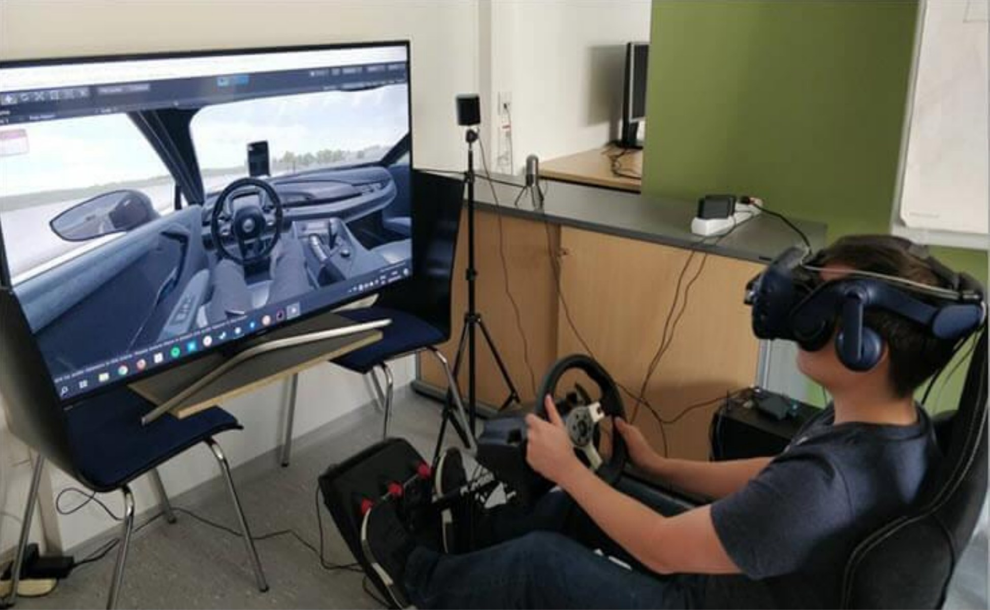



Step inside a simulated world
VIRTUAL REALITY
A simulation of a real or imagined environment, experienced visually in three dimensions.
A POWERFUL MEDIUM FOR
Communication
Entertainment
Learning
Introduction to Information Systems
24
Notes:
Virtual reality is the simulation of a real or imagined environment that can be experienced visually in three dimensions. It can be a powerful medium for communication, entertainment and learning. The photo is from the lecture: a user wearing a VR headset sits in a driving rig with a steering wheel and pedals, while the screen beside him shows the virtual car interior he is seeing. Setups like this are used to test car designs and train drivers without risk. Ask the class where else VR could help, for example surgical training, virtual tours of buildings, or games; those examples are ours.

Slide 25



Creating or modifying business systems
SYSTEMS DEVELOPMENT
In-house
Outsourced
In steps
Performed by the organization’s own staff
Contracted to an outside company
Dividing a project into several steps improves its results
Introduction to Information Systems
25
Notes:
The last topic of the lecture is how systems come into being. Systems development is the activity of creating or modifying existing business systems. It can be performed in-house, by the organization’s own IS staff, or outsourced to an outside company. Either way, to improve the results of a systems development project, it is divided into several steps, so that each stage can be planned, checked and controlled. The next slide shows those steps. The short descriptions of in-house and outsourced work are ours; we will return to systems analysis and design in detail in week 11.

Slide 26
Five steps from problem to working system
FIGURE 1.14 · AN OVERVIEW OF SYSTEMS DEVELOPMENT
1
Investigation
Gain understanding of the problem to solve or opportunity to address
Understand problem
2
Analysis
Define problems and opportunities of the existing system
Understand solutions
Design
3
Select and plan best solution
How the new system will meet the business needs found in analysis
Implementation
Feedback lets any step loop back to an earlier one
Create or acquire the components, assemble them, put the system into operation
4
Place solution into effect
5
Maintenance & review
Check and modify the system so it keeps meeting changing business needs
Evaluate results
Introduction to Information Systems
26
Notes:
Figure 1.14 gives an overview of systems development as five steps, each with a short goal. One, systems investigation, understand the problem: gain an understanding of the problem to be solved or the opportunity to be addressed. Two, systems analysis, understand solutions: define the problems and opportunities of the existing system. Three, systems design, select and plan the best solution: decide how the new system will work to meet the business needs defined during analysis. Four, systems implementation, place the solution into effect: create or acquire the system components defined in design, assemble them, and put the new system into operation. Five, systems maintenance and review, evaluate the results: check and modify the system so that it continues to meet changing business needs. In the figure, arrows on the left loop back from each step to earlier ones, because what we learn later often sends us back to revise earlier work. We will study these steps in depth in week 11.

Slide 27
Name that concept
QUICK REVIEW
1 · Raw facts are called…
Data
6 · Records completed business transactions
TPS
2 · Facts organized to have extra value
Information
7 · Integrated programs for a multisite firm
ERP
3 · Output used to change input or processing
Feedback
8 · The primary focus of an MIS
Operational efficiency
4 · Strategies, policies, methods and rules of a CBIS
Procedures
9 · The focus of a DSS
Decision-making effectiveness
5 · Consumers selling to other consumers
C2C
10 · The first step of systems development
Systems investigation
Introduction to Information Systems
27
Notes:
A quick review to close the lecture. The lecture file has no quiz, so these ten questions are ours, built directly from its definitions. Read each one, let students answer, then click to reveal the answers one at a time. One: data. Two: information. Three: feedback. Four: procedures. Five: C2C, consumer-to-consumer e-commerce. Six: a transaction processing system, TPS. Seven: enterprise resource planning, ERP. Eight: operational efficiency. Nine: decision-making effectiveness. Ten: systems investigation. The left column, answers in blue, covers concepts and components; the right column, answers in coral, covers business systems and development.

Slide 28
Six ideas to take away
SUMMARY
1
Data are raw facts; organized with knowledge, they become information
2
Information is worth what it helps decision makers achieve
3
Every IS runs input → processing → output, with feedback
4
A CBIS joins hardware, software, data, telecoms, people and procedures
5
Business IS climb from TPS, ERP and e-commerce to MIS, DSS and AI
6
Systems are built in steps: investigate, analyze, design, implement, maintain
Introduction to Information Systems
28
Notes:
To sum up today’s lecture in six ideas. One: data are raw facts, and when we apply knowledge to select, organize and manipulate them, they become information. Two: the value of information depends on how it helps decision makers achieve the organization’s goals, measured for example in decision time or profit. Three: every information system follows the input, processing, output model, with feedback used to adjust input and processing. Four: a computer-based information system brings together hardware, software, databases, telecommunications and networks, people and procedures. Five: business information systems form a pyramid, from e-commerce, TPS and ERP at the base, through MIS and DSS, to knowledge management, AI, expert systems and virtual reality at the top. Six: systems are developed step by step: investigation, analysis, design, implementation, and maintenance and review. Next week we build on this with the foundations of information systems in business.

